Slide 1
The space Invader -Group 80

Slide 2
Team-Members
Arya Nath
Abhijit Maity
Mohan Kumar Jana
Sagor Mondal
Arigna Adhikari
Sayak Sarkar
Suprotim Karmakar
Bratin Das
Under The Guidance Of Respected :
Prof. Dr. Maumita Chakraborty Prof. Prasenjit Kumar Das
Project Guide Project Guide
HOD, Department of Computer Science and Technology Assistant Professor, Department of Computer Science and Technology
UEM, Kolkata UEM, Kolkata

Slide 3
Table of contents
01
02
03
04
Introduction
Working
Origin of the Game
The operations and Functionality of the game
Future
Conclusion
Scope for future improvements
Summary of the Project

Slide 4
01
Introduction
Origin and Why this Project?

Slide 5
Introduction
1. Space Invaders is a 1978 shoot’em up arcade game developed by Tomohiro Nishikado. It was manufactured and sold by Taito in Japan, and licensed to the Midway division of Bally for overseas distribution.
2. Space Invaders was the first fixed shooter and set the template for the shoot’em up genre.
3. The goal is to defeat wave after wave of descending aliens with a horizontally moving laser to earn as many points as possible.

Slide 6
Why this Project?
We made this project out of sheer nostalgia, this is our humble and simple approach to revive and relive our Childhood. A game that has brought happiness to people of multiple generations and multiple age groups. This is our attempt in recreating a game, an experience that has ruled over the arcade genre for several years Another reason of recreating this project is because of the simple and undemanding nature of the code Which helps novice coders like us to elevate and learn the basics before going to the advance mechanisms.

Slide 7
Objective and working
02

Slide 8
AIM
The aim is to destroy the rows of aliens as they move horizontally across the screen, moving faster and faster as you pass levels. Once you destroy one wave of aliens get ready to face another faster and more difficult wave of aliens. If you allow any space invaders to reach the bottom of the screen or enemies bullets consume your lives, the alien invasion has been successful and the game end.

Slide 9
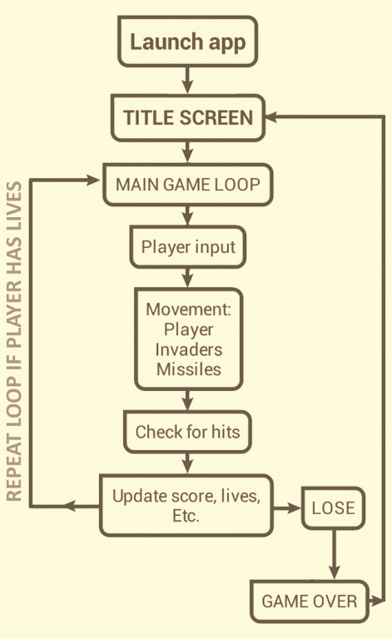
Flow Chart of the Game

Slide 10
Working of The Game
Import the required module.
Initialize the pygame.
PYGAME :- Pygame is a cross-platform set of Python modules designed for writing video games. It includes computer graphics and sound libraries designed to be used with the Python programming language .
FUNCTIONS:
isCollision(): Which tells us whether the collision has occurred or not?

Slide 11
Working of The Game
game_over(): Which returns True or False on the basis of which the code decided if the game has ended.
show_score(x, y): This shows the score on the screen
Create an infinite loop to execute the code continuously.
These are the functions and application platforms used to make the game, some snapshots of the game can be seen on the next slide

Slide 12

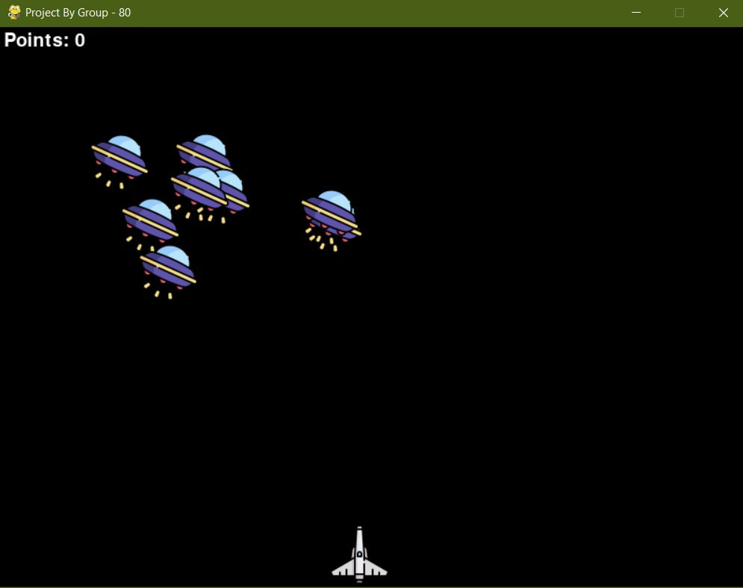
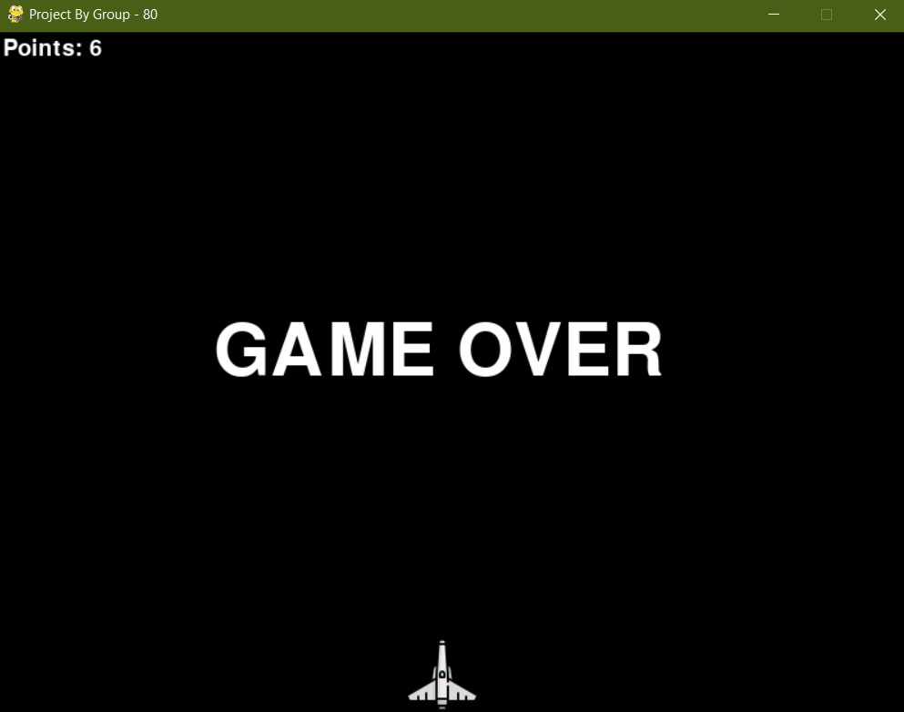
Snapshots from the Game

Slide 13
Future of the game
03

Slide 14
Future of the Project
Although this project is in its beginner stage, it already Improved our coding skills. We have the following Ideas for the improvement of the game
To the make the rounds more challenging and unique than the previous rounds.
To make the gameplay more interactive and visually appealing.
To patch any glitch and latency of the game.
We’ve a plan to include a second player for a multiplayer experience.
We can develop more arcade games based on this design model.

Slide 15
Conclusion
04

Slide 16
Conclusion
To conclude this, this is our humble and simple approach to rekindle our childhood and nostalgia, a game that has bought happiness to countless people. We have plans of making the rounds and gameplay more interactive and unique. This can be a great time-pass and also a way to relive one’s childhood

Slide 17
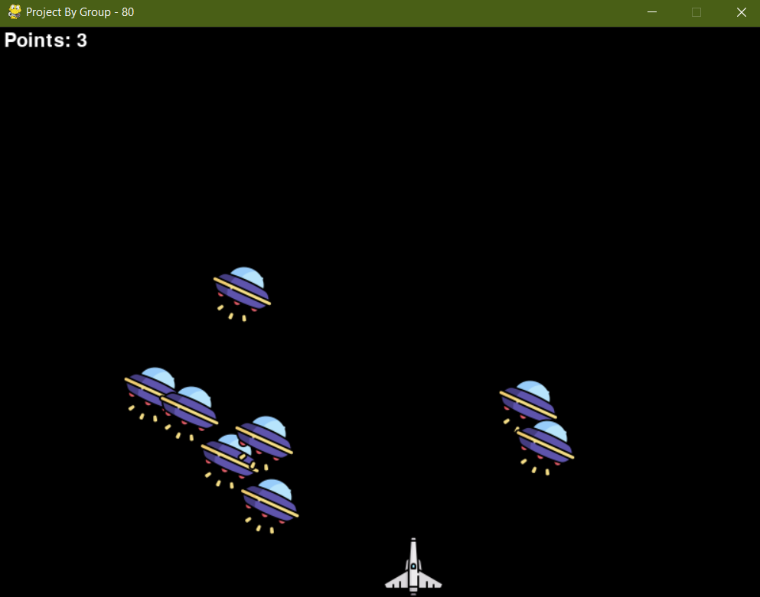
Thanks!
Group Project of Group no. 80

